Slide 1
General Districting Considerations
Legal Requirements
Geography
Neighborhoods
Physical Layout
School Districts and Other Areas
Political Participation
Voter Registration
Voter Turnout
Ethnic Shares
Demographic Characteristics
Population by Ethnicity
Voting Age Population by Ethnicity
Citizen Voting Age by Ethnicity
Socio-Economic Characteristics
Income
Home Ownership
Age of Housing
Length of Residence
Public Input

Slide 2
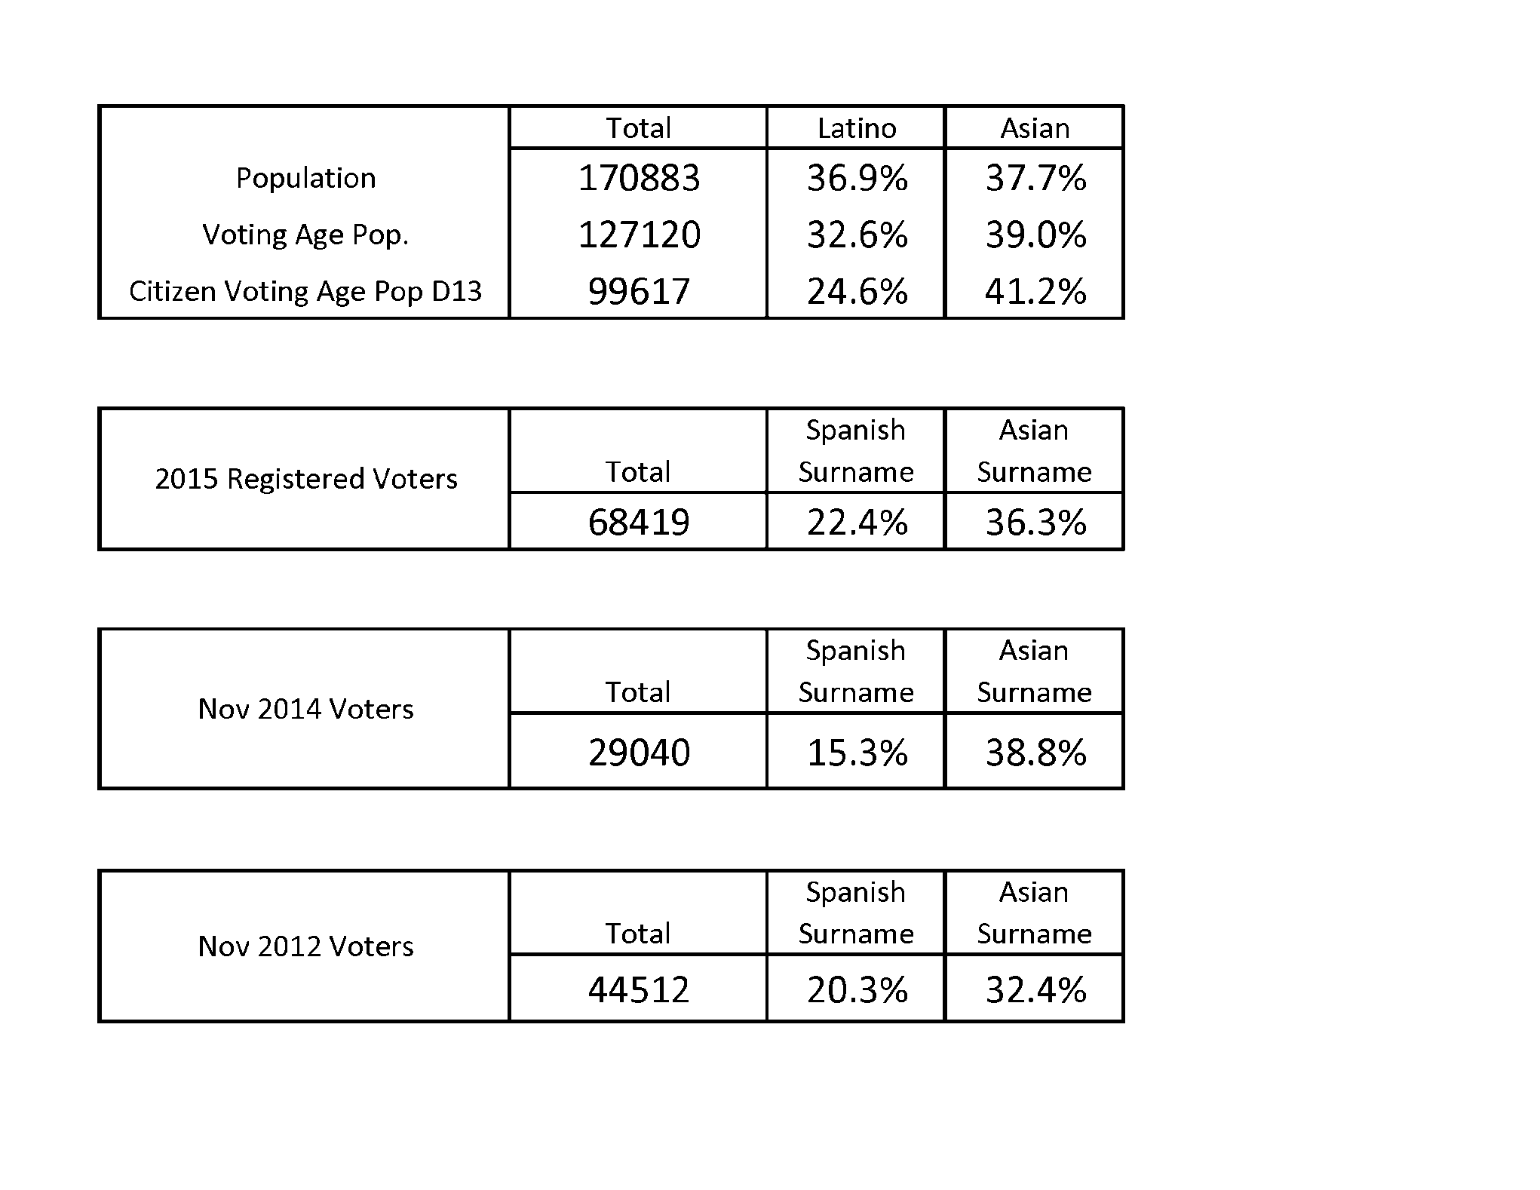
Demographic Data

Slide 3
Median Income

Slide 4
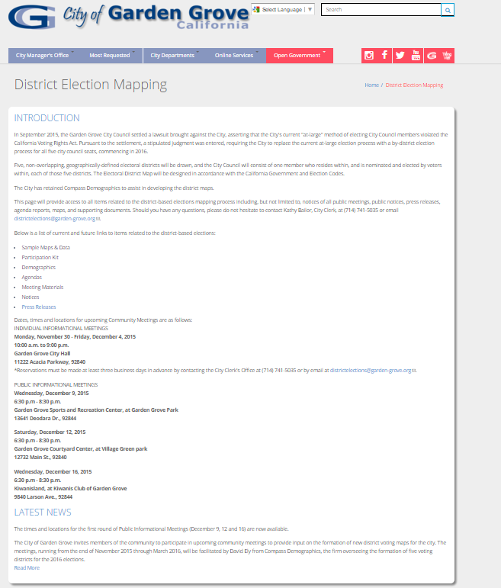
Opportunities for Participation
Visit the City of Garden Grove website for additional details.
http://www.ci.garden-grove.ca.us/citymanager/CityClerk/DistrictElectionMapping

Slide 5
Participation Kit – Create your own map
The Public Participation Kit contains:
Instruction sheet
PDF map of city, which divide the city into Census Block Groups
An "Assignment" worksheet showing the demographic data for each Population Unit
A "Balance" worksheet which shows the totals resulting from your assignments
How to create a district map:
Start with a base map
Review the Census Block Groups and population numbers
Begin to identify hard boundaries, communities of interest, population numbers

Slide 6
Participation Kit - Report
As you update your district assignments of each Population Unit, you will see the totals automatically update on the “Balance" tab.
The table shows you the summary statistics for each district, including information for Total Population, Voting Age Population.
The table also shows you the population deviations from the ideal population target of XX,XXX.
Plans should come as close as possible to being equal in population.
You can justify your small deviations by providing additional information when you submit.

Slide 7
Group Exercise
Workgroups of 8-10 participants per table
Use table map to identify:
Neighborhoods or communities
Connections
Barriers
Divisions
Points of interest
Review and prioritize sample maps
Report group findings
Questions and answers

Slide 8
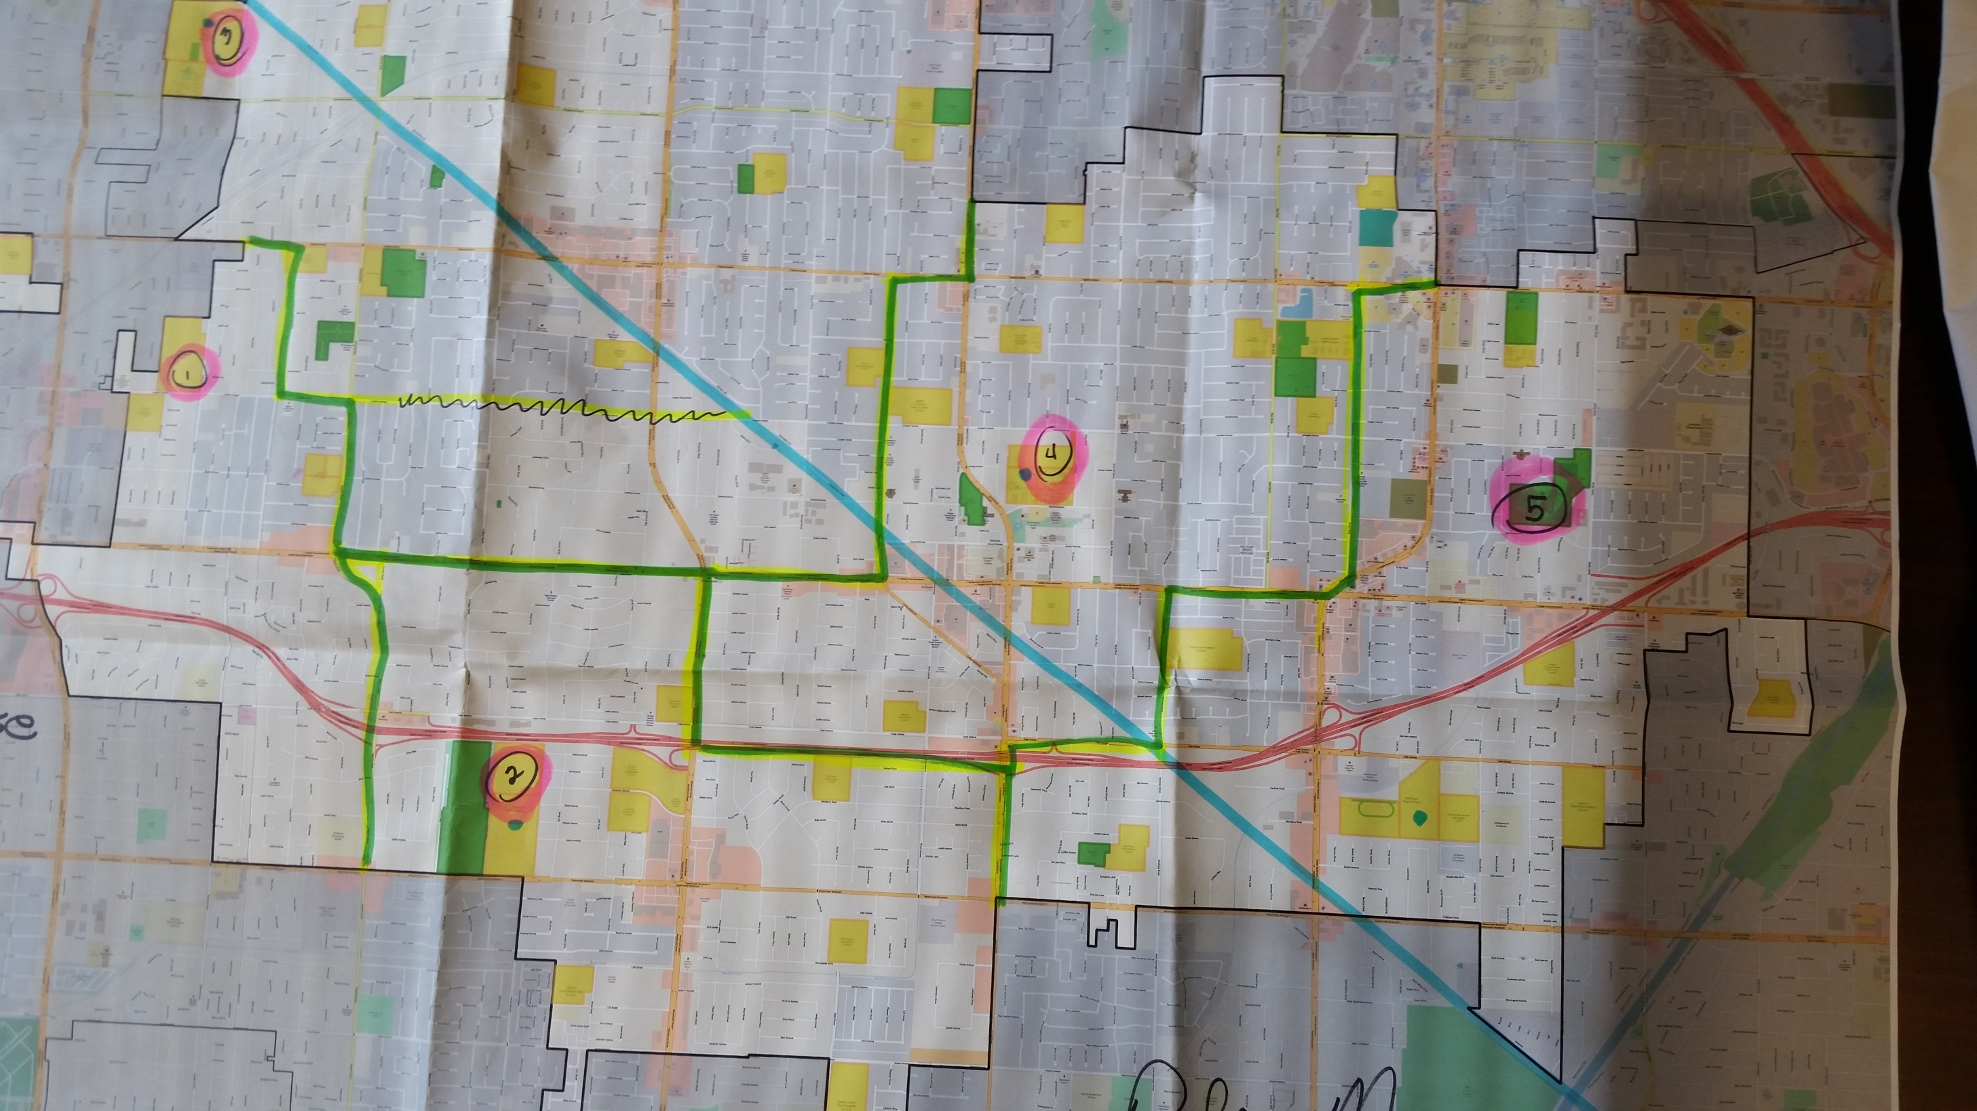

Slide 9
Community Meetings – Some Major Discussion points
East Garden Grove known as Latino Area: common denominators: language, schools, churches, interest
Use major streets as natural barriers, rather than smaller streets within the neighborhoods. For example: Harbor Boulevard, Euclid Street, Garden Grove Freeway.
Keep Islamic Society of Orange County Center, Hill School, and Orange Crescent School within single District. Muslim Community tries to stay within an area that they can walk. On certain religious days they do not drive. Helps allow them to work/live within parameters of religious beliefs.
Little Saigon district would keep similar areas of interest together.
Each district should have one high school.
PE Right of Way to go through three districts for the purpose of building collaboration as there would be a vested interest in improving ROW for public use.
Use School Boundaries.

Slide 10
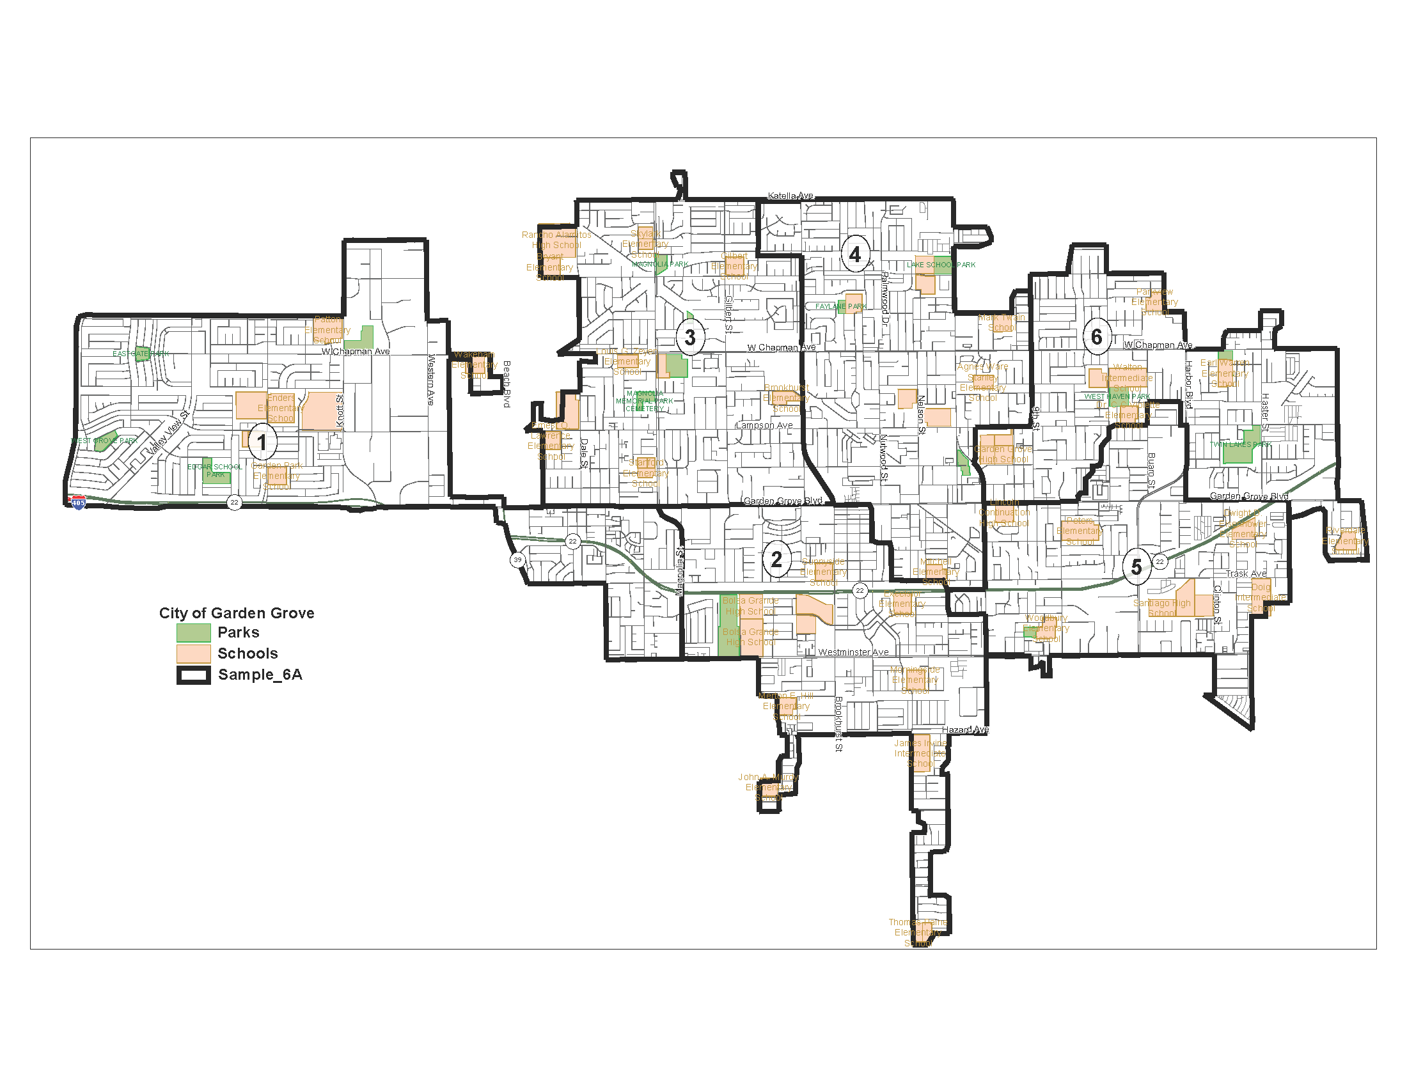
Sample 6 District Map

Slide 11
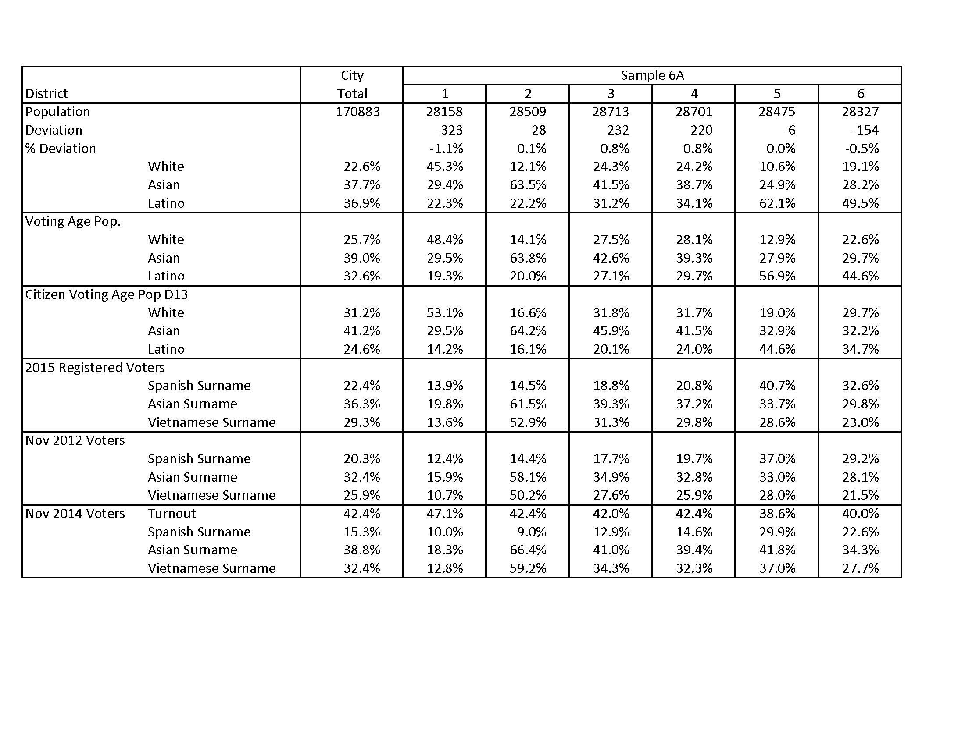
Sample 6 District Table

